Slide 1

1
CHAPTER
INTRODUCTION
Copyright © 2013 by John Wiley & Sons. All rights reserved.
Slides by Donald W. Smith
TechNeTrain.com
Final Draft
Oct. 15, 2011

Slide 2
Chapter Goals
To learn about computers and programming
To compile and run your first Java program
To recognize compile-time and run-time errors
To describe an algorithm with pseudocode
In this chapter, you will learn how to write and run your first Java program. You will also learn how to diagnose and fix programming errors, and how to use pseudocode to describe an algorithm.
Copyright © 2013 by John Wiley & Sons. All rights reserved.
Page <number>

Slide 3

Contents
Computer Programs
The Anatomy of a Computer
The Java Programming Language
Becoming Familiar with your Programming Environment
Analyzing Your First Program
Errors
Problem Solving:
  Algorithm Design
Copyright © 2013 by John Wiley & Sons. All rights reserved.
Page <number>

Slide 4
1.1 Computer Programs
A Computer Program is a sequence of instructions and decisions
Computers execute very basic instructions in rapid succession
Programming is the act of designing and implementing computer programs
Copyright © 2013 by John Wiley & Sons. All rights reserved.
Page <number>

Slide 5
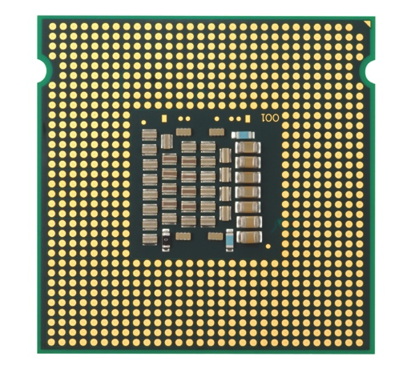
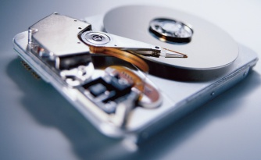
1.2 The Anatomy of a Computer
The central processing unit (CPU) performs program control and data processing
Storage devices include memory (RAM) and secondary storage
  Hard disk
  Flash drives
  CD/DVD drives
Input/Output devices allow the user to interact with the computer
  Mouse, keyboard, printer, screen…
Copyright © 2013 by John Wiley & Sons. All rights reserved.
Page <number>

Slide 6
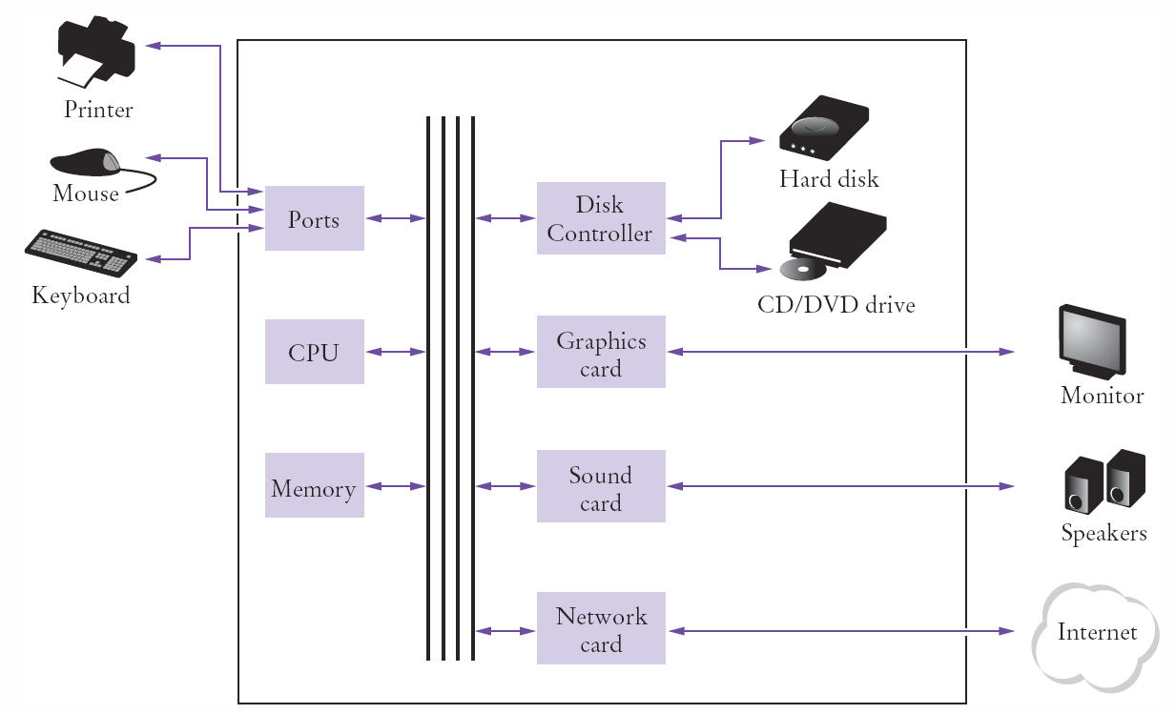
Schematic Design of a PC
Copyright © 2013 by John Wiley & Sons. All rights reserved.
Page <number>

Slide 7
When you‘run’ a program
Program instructions and data (such as text, numbers, audio, or video) are stored on the hard disk, on a compact disk (or DVD), or elsewhere on the network.
When a program is started, it is brought into memory, where the CPU can read it.
The CPU runs the program one instruction at a time. The program may react to user input
As directed by these instructions and the user, the CPU reads data, modifies it, and writes it back to memory, the screen or secondary storage.
Copyright © 2013 by John Wiley & Sons. All rights reserved.
Page <number>

Slide 8
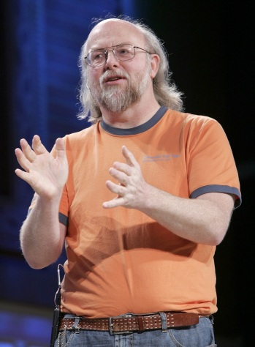
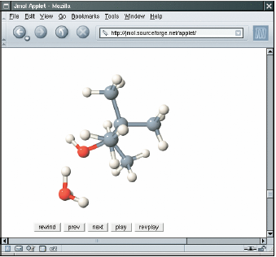
1.3 The Java Language
In 1991, James Gosling of Sun Microsystems designed what would become the Java programming language
Java was originally designed for programming consumer devices, but it was first successfully used to write Internet applets
  An applet is typically embedded inside a web page and runs in the context of a browser
Copyright © 2013 by John Wiley & Sons. All rights reserved.
Page <number>

Slide 9
Java History
Java Design Goals
  Safe: Can be run inside a browser and will not attack your computer
  Portable: Run on many Operating Systems
    Windows
    Mac OS
Java programs are distributed as instructions for a ‘virtual machine,’ making them platform-independent
  Virtual machines are available for most Operating Systems. The iPhone is a notable exception
Copyright © 2013 by John Wiley & Sons. All rights reserved.
Page <number>

Slide 10
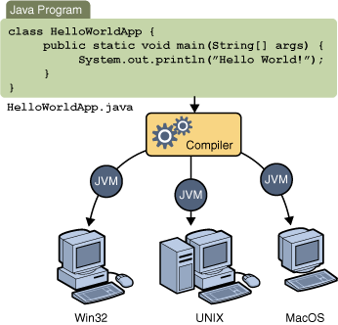
Java Virtual Machines
Source code
Portable ‘byte code’
  The compiler generates byte code in a ‘class’ file which can be run on any Java Virtual Machine
Oracle Tutorials
Copyright © 2013 by John Wiley & Sons. All rights reserved.
Page <number>

Slide 11
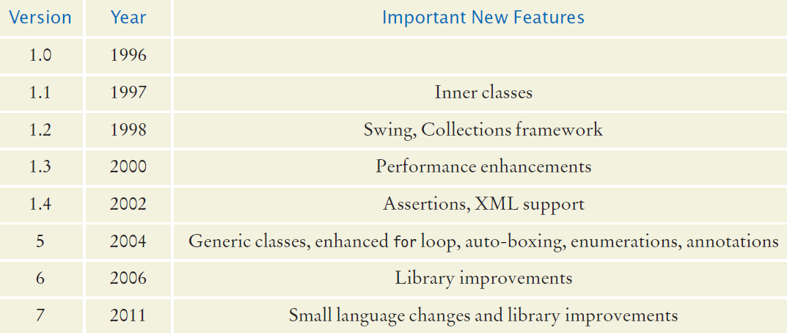
Java Timeline
Java is evolving: Major revisions
Oracle purchased Sun (along with Java) in 2010
  There are still quite a few references and links to Sun Microsystems which are now re-directed to Oracle
Copyright © 2013 by John Wiley & Sons. All rights reserved.
Page <number>

Slide 12
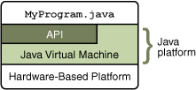
The Java API
The Java Platform consists of two parts:
  1) Java Virtual Machine
  2) Java API
  -- also called libraries
The Application Programming Interface (API) is a huge collection of handy software packages that programmers can use:
  Graphics, user interface, networking, sound, database, math, and many more
Copyright © 2013 by John Wiley & Sons. All rights reserved.
Page <number>

Slide 13
The Java SDK
You need to install the Java SDK (Software Development Kit) to create Java programs
  Google ‘Java SDK download,’ Get SE version
  Location after installed on Windows will be:
    C:\Program Files\Java\jdk1.7.x
    The last few numbers may vary with releases
The SDK includes programs such as:
  java.exe (Executes Java applications)
  javac.exe (Java compiler)
  javadoc.exe (Javadoc generator)
Copyright © 2013 by John Wiley & Sons. All rights reserved.
Page <number>

Slide 14
1.4 Programming Environment
There are many free programming tools available for Java
  I recommend using TextPad or Eclipse
Components of an Integrated Development Environment (IDE):
  Source code editor helps programming by:
    Listing line numbers of code
    Color lines of code (comments, text…)
    Auto-indent source code
  Output window
  Debugger
Copyright © 2013 by John Wiley & Sons. All rights reserved.
Page <number>

Slide 15
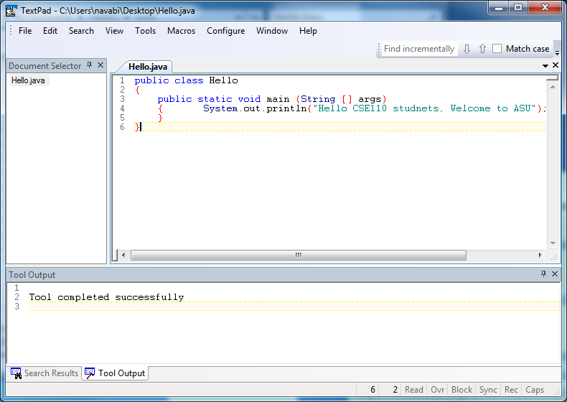
Example of TextPad
Editor
Output
Copyright © 2013 by John Wiley & Sons. All rights reserved.
Page <number>

Slide 16
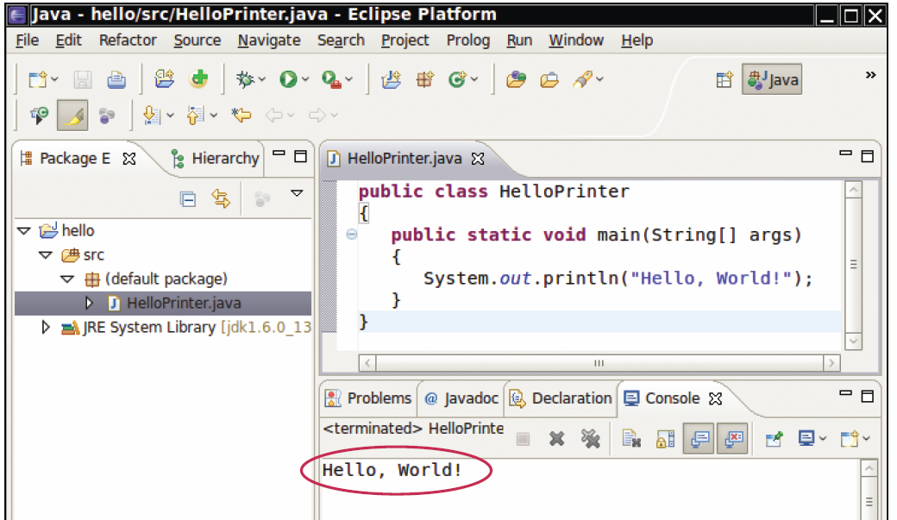
An Example IDE
Editor
Output
Many IDEs are designed specifically for Java programming
Copyright © 2013 by John Wiley & Sons. All rights reserved.
Page <number>

Slide 17
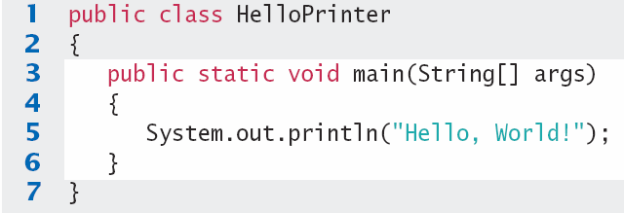
Your First Program
Traditional ‘Hello World’ program in Java
We will examine this program in the next section
  Typing it into your IDE would be good practice!
  Be careful of spelling
  JaVa iS CaSe SeNsItiVe
  Java uses special characters, e.g. { } ( ) ;
Copyright © 2013 by John Wiley & Sons. All rights reserved.
Page <number>

Slide 18
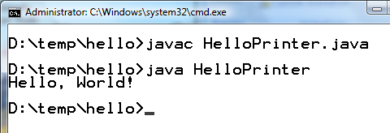
Text Editor Programming
You can also use a simple text editor such as Notepad to write your source code
Once saved as HelloPrinter.java, you can use a console window to:
  Compile the program
  Run the program
Compile
Output
Execute
Copyright © 2013 by John Wiley & Sons. All rights reserved.
Page <number>

Slide 19
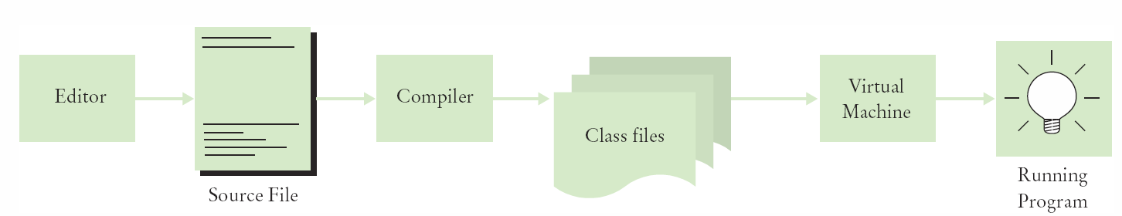
Source Code to Running Program
The compiler generates the .class file which contains instructions for the Java Virtual machine
Class files contain ‘byte code’ that you cannot edit
  D:\temp\hello>Type HelloPrinter.class
  ╩■║╛ 2 ↔ ♠ ☼ ► ↕ ‼ ¶ § ▬☺ ♠<init>☺ ♥()V☺ ♦Code☺ ☼LineNumberTable☺ ♦main▬([Ljava/lang/String;)V☺
  Hello, World! elloPrinter.java♀ ↨♀ ↑ ↓☺
Copyright © 2013 by John Wiley & Sons. All rights reserved.
Page <number>

Slide 20
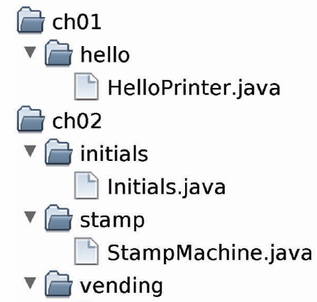

Organize your work
Your ‘source code’ is stored in .java files
Create one folder per program
  Can be many .java files
Be sure you know where your IDE stores your files!
Backup your work!
Backup your work to a Flash Drive, external hard drive, or network drive that is backed up nightly.
Copyright © 2013 by John Wiley & Sons. All rights reserved.
Page <number>

Slide 21

1.5 Analyzing your First Program
1: Declares a ‘class’ HelloPrinter
-- Every Java program has one or more classes.
3: Declares a method called ‘main’
-- Every Java application has exactly one ‘ main’ method
-- Entry point where the program starts
5: Method System.out.println outputs ‘Hello, World!’
-- A statement must end with a semicolon (;)
Copyright © 2013 by John Wiley & Sons. All rights reserved.
Page <number>

Slide 22
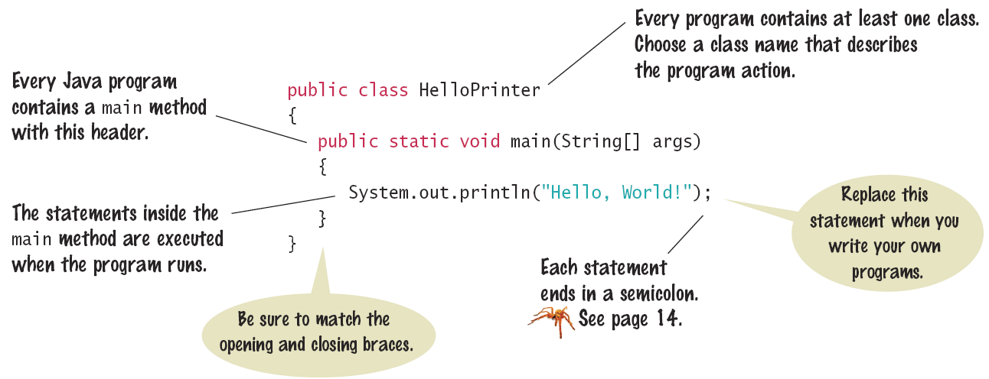
Syntax 1.1: The Java Program
Every application has the same basic layout
  Add your ‘code’ inside the main method
Copyright © 2013 by John Wiley & Sons. All rights reserved.
Page <number>

Slide 23
Calling Java Library methods
Line 5 shows how to ‘call’ a ‘method’ from the Java API: System.out.println
  Code that somebody else wrote for you!
  Notice the dots (periods)
  Parenthesis surround the arguments that you ‘pass’ to a method
  We are passing a String “Hello World”
    Note the double quotes which denote a String inside
  You can also print numerical values
    System.out.println(3 + 4);
Copyright © 2013 by John Wiley & Sons. All rights reserved.
Page <number>

Slide 24
Getting to know println
The println method prints a string or a number and then starts a new line.
    System.out.println("Hello");
    System.out.println("World!”);
Hello
Hello
World!
println has a ‘cousin’ method named print that does not print a new line.
    System.out.print("00");
    System.out.println(3+4);
00
007
A method is called by specifying the method and its agruments
Copyright © 2013 by John Wiley & Sons. All rights reserved.
Page <number>

Slide 25

Common Error 1.1
Omitting Semicolons
  In Java, every statement must end in a semicolon. Forgetting to type a semicolon is a common error. It confuses the compiler, because the compiler uses the semicolon to find where one statement ends and the next one starts. For example, the compiler sees this:
  As this:
  It doesn’t understand this statement, because it does not expect the word System following the closing parenthesis after Hello.
System.out.println("Hello")
System.out.println("World!");
System.out.println("Hello") System.out.println("World!");
Copyright © 2013 by John Wiley & Sons. All rights reserved.
Page <number>

Slide 26

1.6 Errors
The Two Categories of Errors:
  1) Compile-time Errors
    Syntax Errors
      Spelling, Capitalization, punctuation
      Ordering of statements, matching of braces/parenthesis…
    No .class file is generated by the compiler
    Correct first error listed, then compile again
  2) Run-time Errors
    Logic Errors
    Program runs, but produces unintended results
    Program may ‘crash’
Copyright © 2013 by John Wiley & Sons. All rights reserved.
Page <number>

Slide 27
Syntax Errors
What happens if you
  Misspell a word: System.ou.println
  Don’t Capitalize a word system.out.println
  Leave out a word void
  Forget a Semicolon after ("Hello, World!")
  Don’t match a curly brace? Remove line 6
Try it to see what error messages are generated
Copyright © 2013 by John Wiley & Sons. All rights reserved.
Page <number>

Slide 28
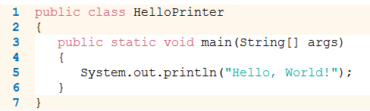
Logic Errors
What happens if you
  Divide by Zero System.out.println(1/0);
  Mis-spell output ("Hello, Word!")
  Forget to output Remove line 5
Programs will compile and run
  The output may not be as expected
Copyright © 2013 by John Wiley & Sons. All rights reserved.
Page <number>

Slide 29
1.7 Problem Solving: Algorithm Design
Algorithms are simply plans
  Detailed plans that describe the steps to solve a specific problem
You already know quite a few
  Calculate the area of a circle
  Find the length of the hypotenuse of a triangle
Some problems are more complex and require more steps
  Calculate PI to 100 decimal places
  Calculate the trajectory of a missile
Copyright © 2013 by John Wiley & Sons. All rights reserved.
Page <number>

Slide 30
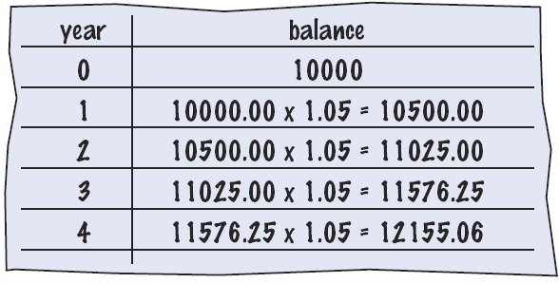
Text Problem to Algorithm
Given the problem:
  You put $10,000 into a bank account that earns 5 percent interest per year. How many years does it take for the account balance to be double the original?
How would you solve it?
  Manual method
    Make a table
    Add lines until done
  Use a spreadsheet!
    Write a formula
      Per line, based on line above
Copyright © 2013 by John Wiley & Sons. All rights reserved.
Page <number>

Slide 31
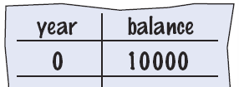
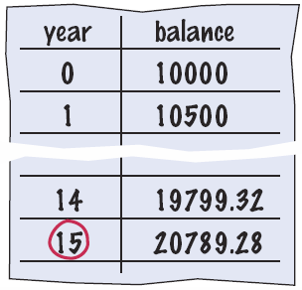
Text Problem to Algorithm Steps
  You put $10,000 into a bank account that earns 5 percent interest per year. How many years does it take for the account balance to be double the original?
Break it into steps
  Start with a year value of 0 and a balance of $10,000
  Repeat the following while the balance is less than $20,000
    Add 1 to the year value
    Multiply the balance by 1.05
      (5% increase)
  Report the final year value as the answer
Copyright © 2013 by John Wiley & Sons. All rights reserved.
Page <number>

Slide 32
Text Problem to Pseudocode
Pseudocode
  Half-way between natural language and a programming language
Modified Steps
  Set the year value of 0
  Set the balance to $10,000
  While the balance is less than $20,000
    Add 1 to the year value
    Multiply the balance by 1.05
  Report the final year value as the answer
This can be translated into Java fairly easily
Pseudocode is an informal description of a sequence of steps for solving a problem
Copyright © 2013 by John Wiley & Sons. All rights reserved.
Page <number>

Slide 33
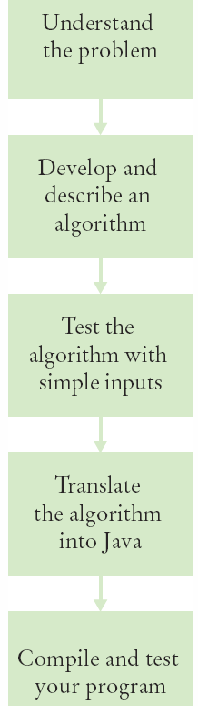
Algorithm Defined
An algorithm describes a sequence of steps that is:
  Unambiguous
    Do not require ‘assumptions’
    Uses precise instructions
  Executable
    Can be carried out in practice
  Terminating
    Will eventually come to an end
Copyright © 2013 by John Wiley & Sons. All rights reserved.
Page <number>

Slide 34
Steps: Algorithm to Pseudocode
You have the choice of buying two cars. One is more fuel efficient than the other, but also more expensive. You know the price and fuel efficiency (in miles per gallon, mpg) of both cars. You plan to keep the car for ten years. Which car is the better deal?
Determine the inputs and outputs
  From the problem statement:
    price1, price2, mpg1, mpg2…
Break down the problem into smaller tasks
  ‘Calculate total cost’ for each car
Describe each subtask as pseudocode
  total cost = purchase price + operating cost
Test your pseudocode with example input
Copyright © 2013 by John Wiley & Sons. All rights reserved.
Page <number>

Slide 35
Summary: Computer Basics
Computers execute very basic instructions in rapid succession.
A computer program is a sequence of instructions and decisions.
Programming is the act of designing and implementing computer programs.
The central processing unit (CPU) performs program control and data processing.
Storage devices include memory and secondary storage.
Copyright © 2013 by John Wiley & Sons. All rights reserved.
Page <number>

Slide 36
Summary: Java
Java was originally designed for programming consumer devices, but it was first successfully used to write Internet applets.
Java was designed to be safe and portable, benefiting both Internet users and students.
Java programs are distributed as instructions for a virtual machine, making them platform-independent.
Java has a very large set of libraries. Focus on learning those parts of libraries that you need for your programming projects.
Copyright © 2013 by John Wiley & Sons. All rights reserved.
Page <number>

Slide 37
Summary: Java
Set aside some time to become familiar with the programming environment that you will use for your class work.
An editor is a program for entering and modifying text, such as a Java program.
Java is case sensitive. You must be careful about distinguishing between upper and lowercase letters.
The Java compiler translates source code into class files that contain instructions for the Java virtual machine.
Copyright © 2013 by John Wiley & Sons. All rights reserved.
Page <number>

Slide 38
Summary: Java
Classes are the fundamental building blocks of Java programs.
Every Java application contains a class with a main method. When the application starts, the instructions in the main method are executed.
Each class contains declarations of methods. Each method contains a sequence of instructions.
A method is called by specifying the method and its parameters.
A string is a sequence of characters enclosed in quotation marks.
Copyright © 2013 by John Wiley & Sons. All rights reserved.
Page <number>

Slide 39
Summary: Errors and Pseudocode
A compile-time error is a violation of the programming language rules that is detected by the compiler.
A run-time error causes a program to take an action that the programmer did not intend.
Pseudocode is an informal description of a sequence of steps for solving a problem.
An algorithm for solving a problem is a sequence of steps that is unambiguous, executable, and terminating.
Copyright © 2013 by John Wiley & Sons. All rights reserved.
Page <number>

